Slide 1
Sketching a Musical Robot
The Artistry of John Halloran and Jason arnold

Slide 2
Needs and Solutions
What we found in our observations is that an essential of element of practice is timekeeping. While people do use a metronome to keep time, it could be useful to have a visual timekeeper. It may also work to visualize that metronome as a conductor, conducting in time and tempo

Slide 3
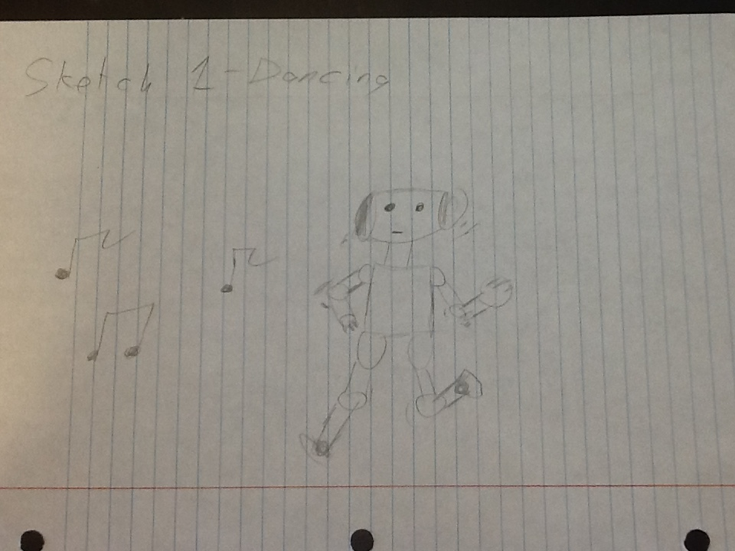

Slide 4
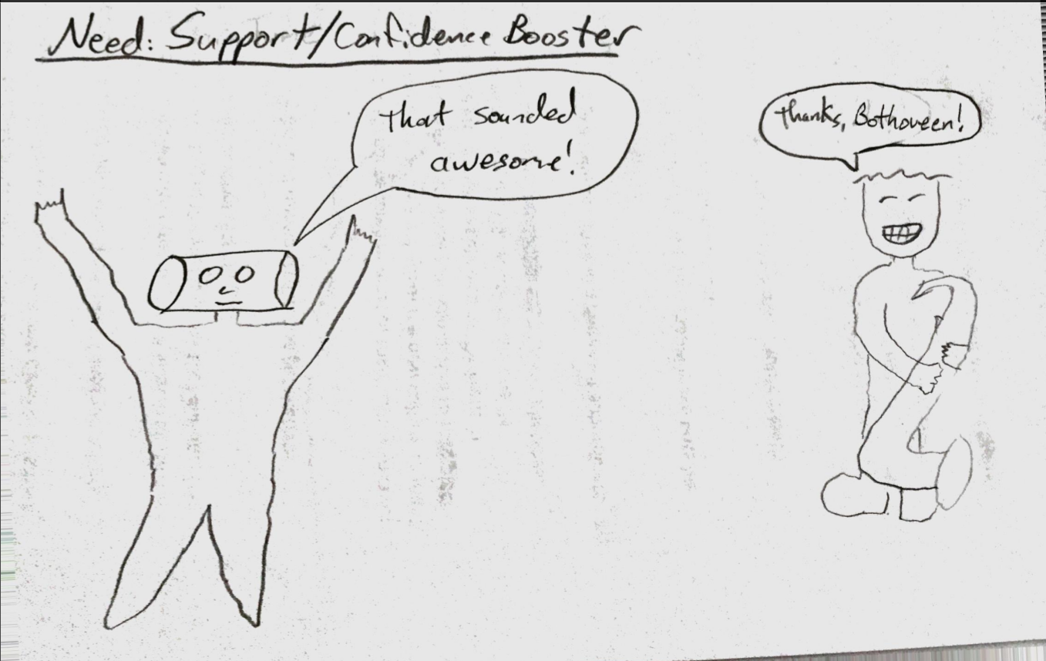

Slide 5
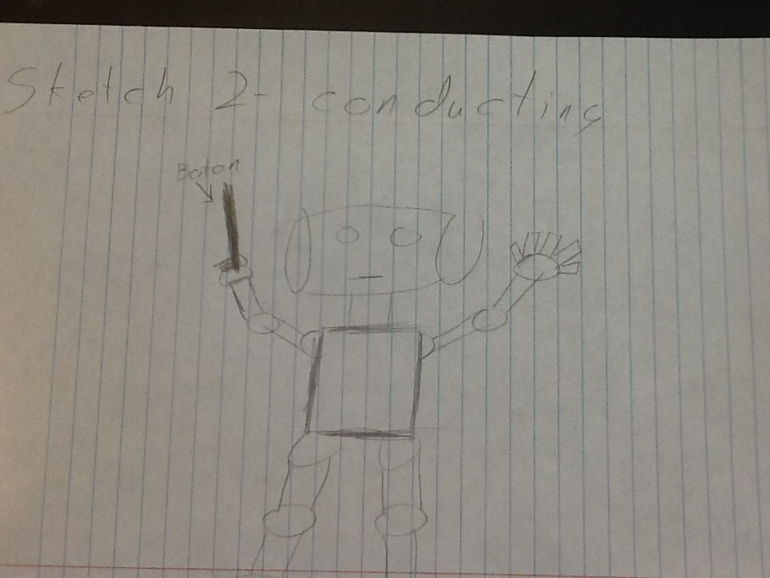

Slide 6
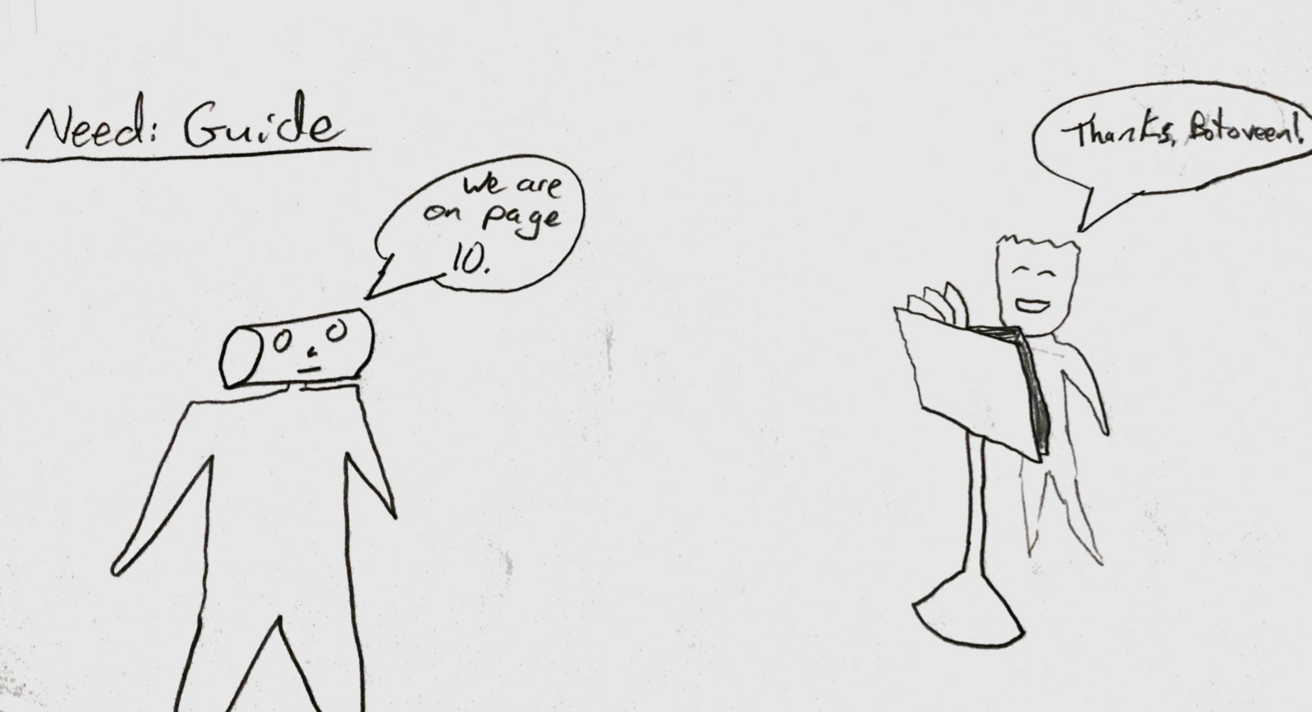

Slide 7
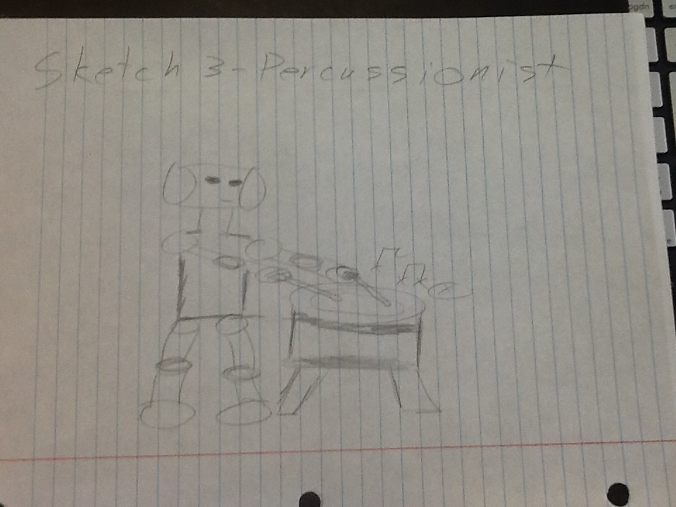

Slide 8
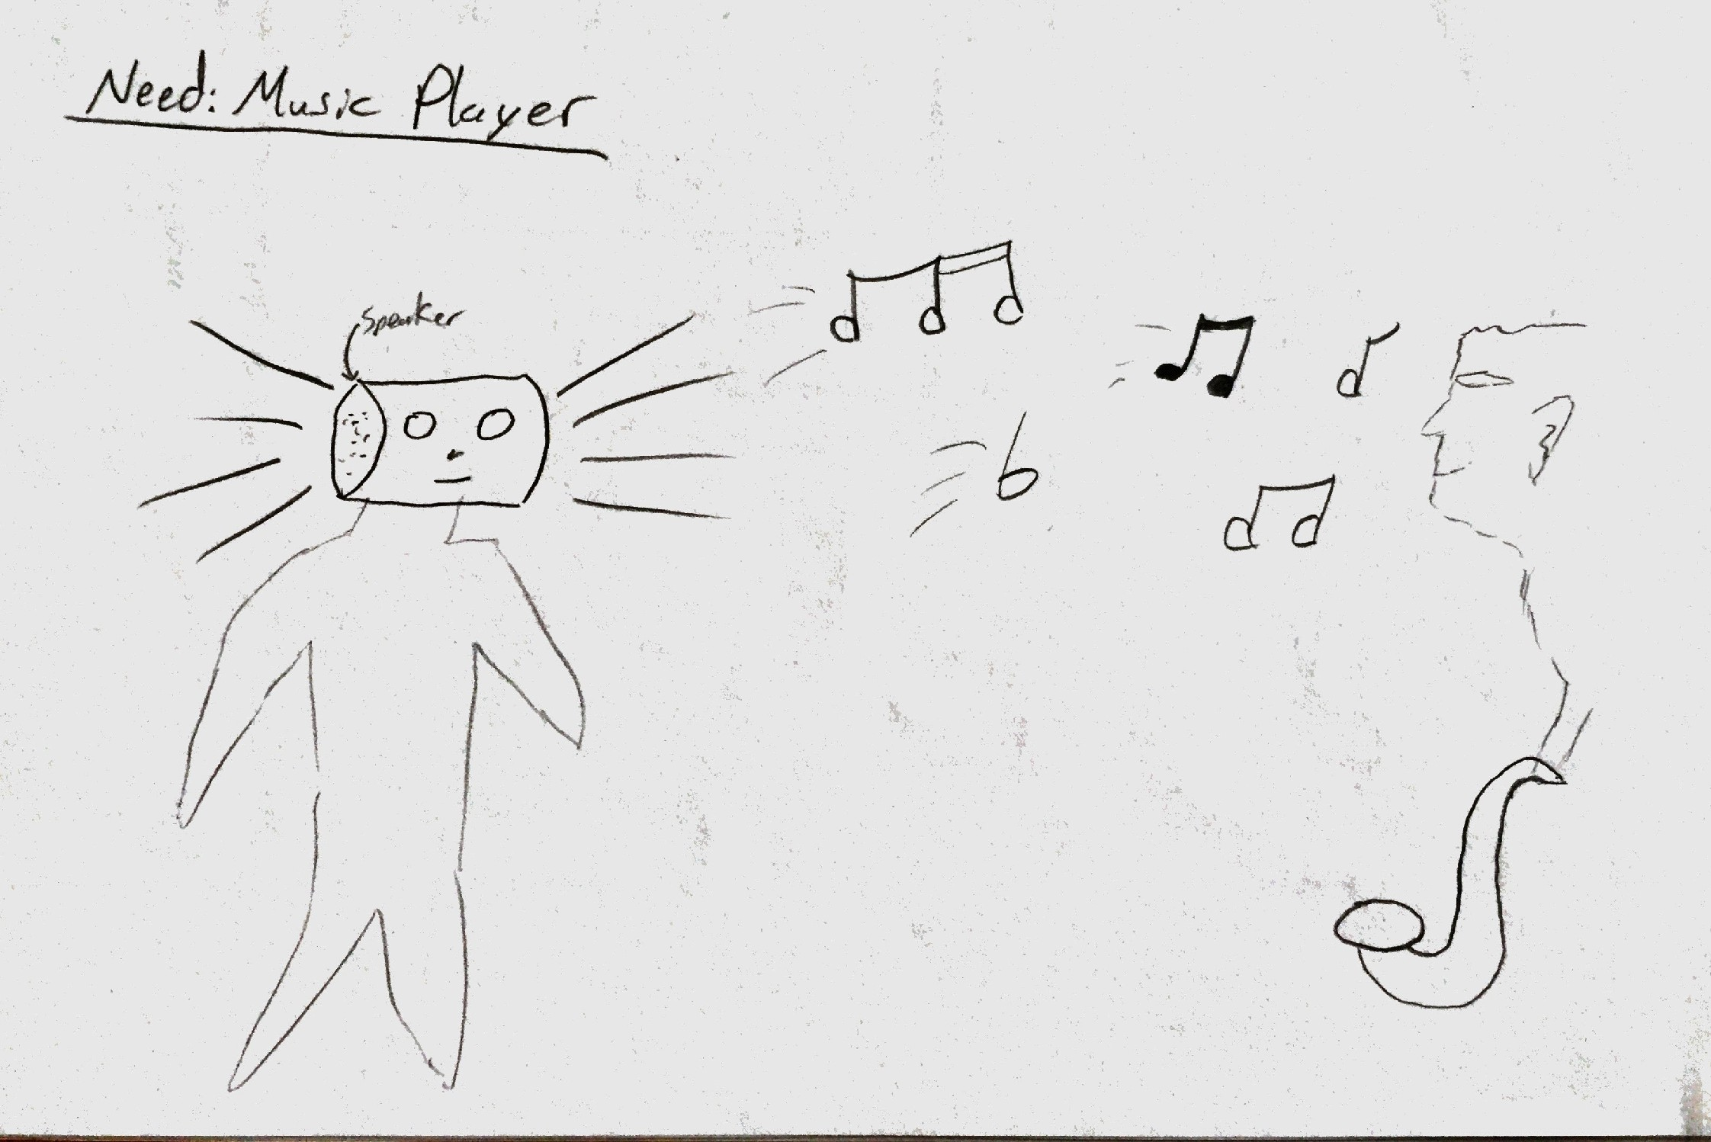

Slide 9
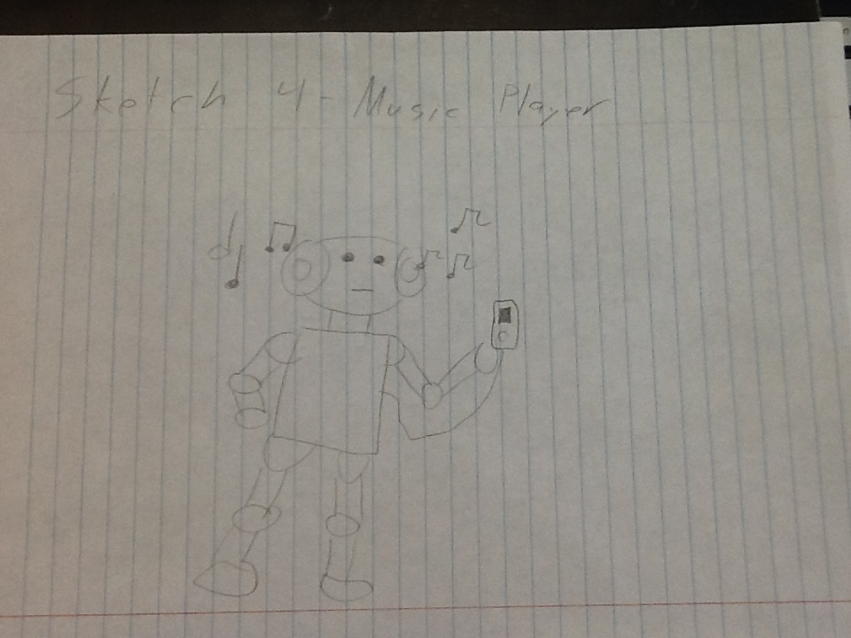

Slide 10
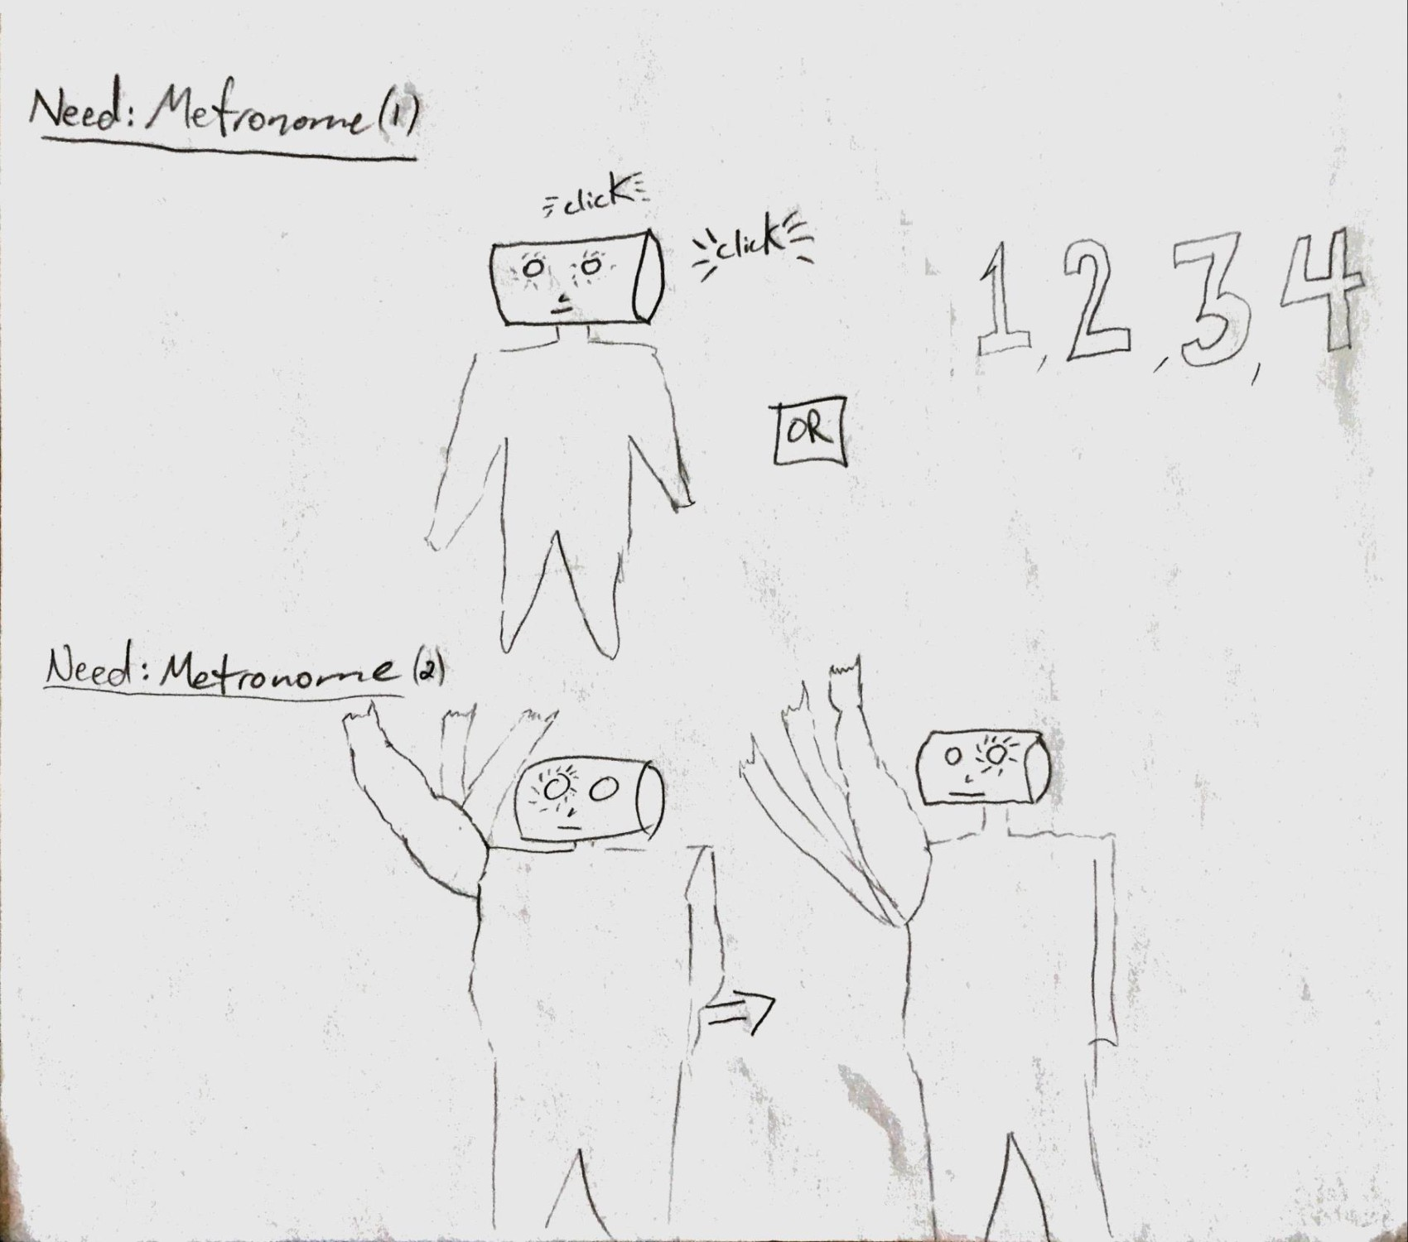

Slide 11
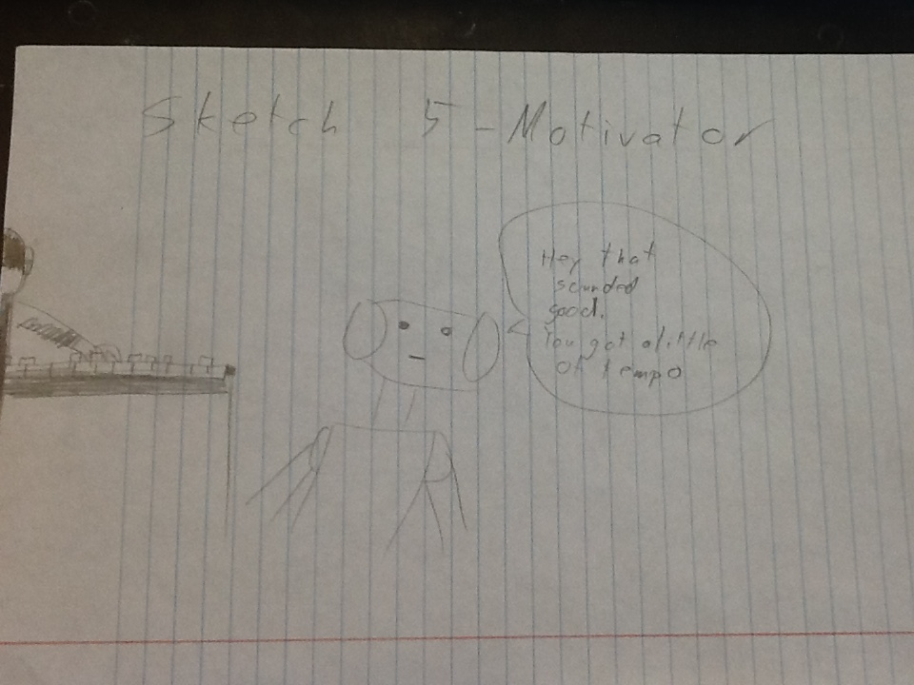

Slide 12
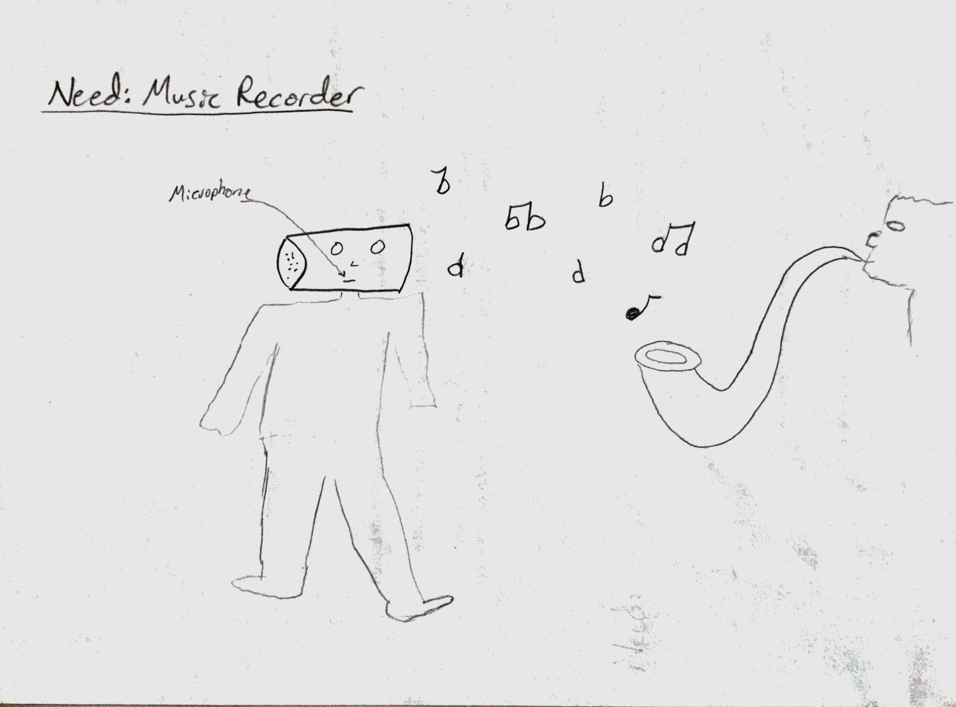

Slide 14
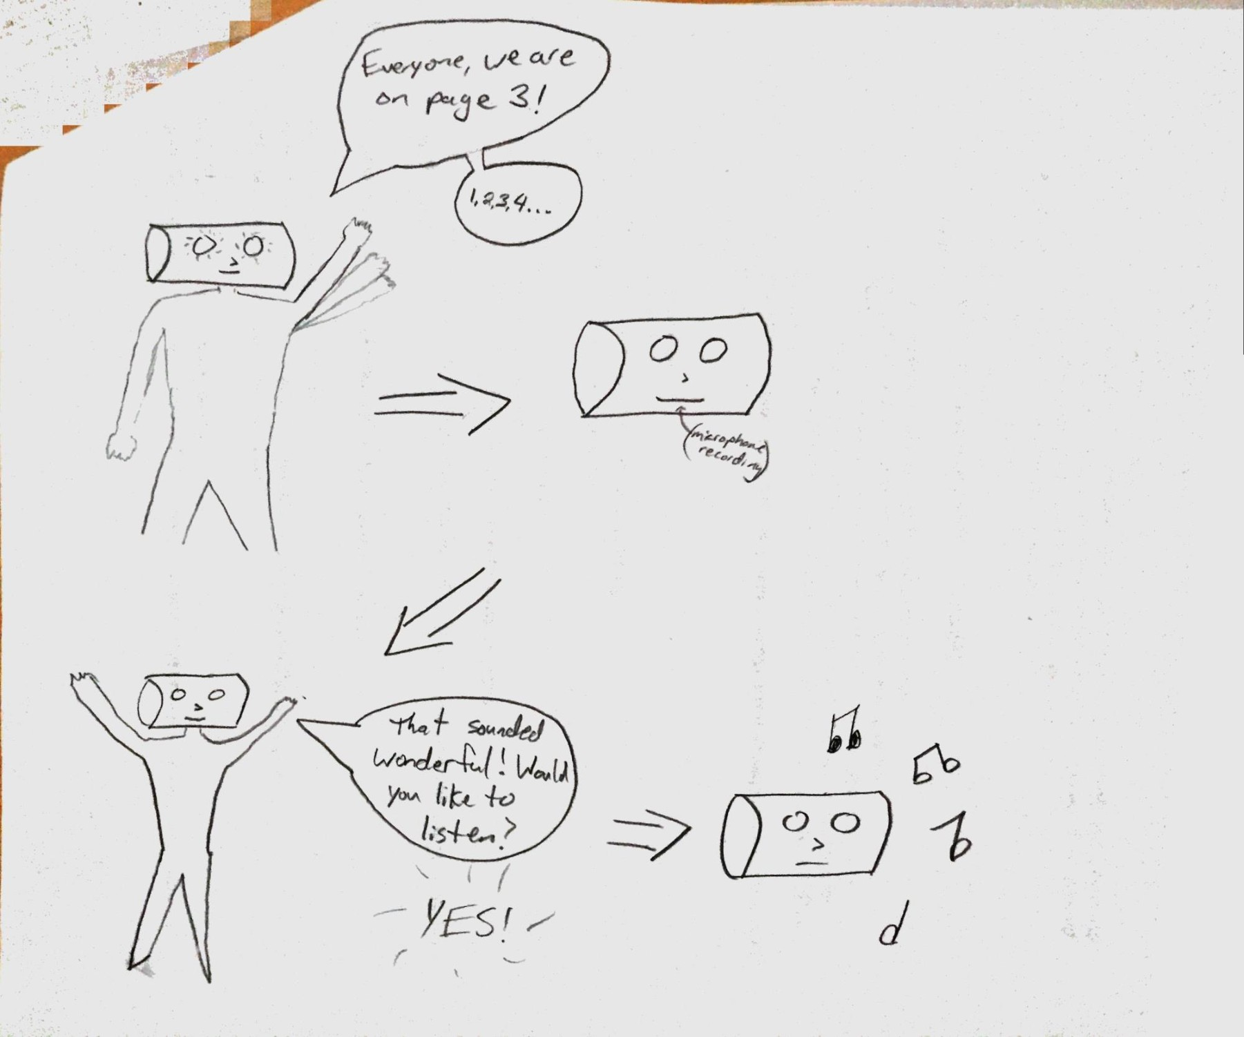

Slide 15
Solution
Obviously the solution has to do with time keeping and an ability to listen
We find it best to create an interaction that allows for the musician to practice with a time keeper
Also to allow that same visual time keeper, to listen and play back what you played

